Slide 1
Intermediate Coding Week 19
Lists

Slide 2

ArrayLists
Notes:
Skip if it’s already past 4:35.

Slide 3
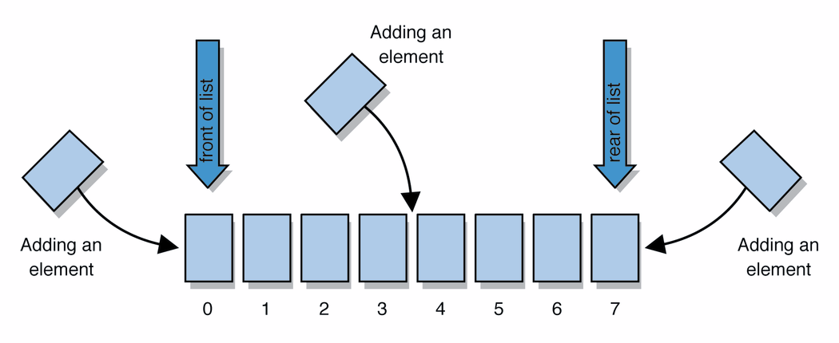
Lists
list: a collection storing an ordered sequence of elements
each element is accessible by a 0-based index
a list has a size (number of elements that have been added)
elements can be added to the front, back, or elsewhere
in Java, a list can be represented as an ArrayList object
Notes:
use jGRASP/DrJava Interactions window to create a list and add some elements, get them, check size

Slide 4
Idea of a list
Rather than creating an array of boxes, create an object that represents a "list" of items. (initially an empty list.)
[]
You can add items to the list.
The default behavior is to add to the end of the list.
[hello, ABC, goodbye, okay]
The list object keeps track of the element values that have been added to it, their order, indexes, and its total size.
Think of an "array list" as an automatically resizing array.
Internally, the list is implemented using an array and a size field.

Slide 5
ArrayList methods
add(value) | appends value at end of list
add(index, value) | inserts given value just before the given index, shifting subsequent values to the right
clear() | removes all elements of the list
indexOf(value) | returns first index where given value is found in list (-1 if not found)
get(index) | returns the value at given index
remove(index) | removes/returns value at given index, shifting subsequent values to the left
set(index, value) | replaces value at given index with given value
size() | returns the number of elements in list
toString() | returns a string representation of the list such as "[3, 42, -7, 15]"

Slide 6
Type Parameters (Generics)
ArrayList<Type> name = new ArrayList<Type>();
When constructing an ArrayList, you must specify the type of elements it will contain between < and >.
This is called a type parameter or a generic class.
Allows the same ArrayList class to store lists of different types.
ArrayList<String> names = new ArrayList<String>();
names.add("George Washington");
names.add("John Adams");

Slide 7
ArrayList vs. array
construction
String[] names = new String[5];
ArrayList<String> list = new ArrayList<String>();
storing a value
names[0] = "Jessica";
list.add("Jessica");
retrieving a value
String s = names[0];
String s = list.get(0);

Slide 8
ArrayList vs. array continued
doing something to each value that starts with "B"
for (int i = 0; i < names.length; i++) {
if (names[i].startsWith("B")) { ... }
}
for (int i = 0; i < list.size(); i++) {
if (list.get(i).startsWith("B")) { ... }
}
seeing whether the value “Bruce Wayne" is found
for (int i = 0; i < names.length; i++) {
if (names[i].equals("Bruce Wayne")) { ... }
}
if (list.contains("Bruce Wayne")) { ... }

Slide 9
ArrayList as parameter
public static void name(ArrayList<Type> name) {
Example:
// Removes all plural words from the given list.
public static void removePlural(ArrayList<String> list) {
for (int i = 0; i < list.size(); i++) {
String str = list.get(i);
if (str.endsWith("s")) {
list.remove(i);
i--;
}
}
}
You can also return a list:
public static ArrayList<Type> methodName(params)

Slide 10
ArrayList of primitives?
The type you specify when creating an ArrayList must be an object type; it cannot be a primitive type.
// illegal -- int cannot be a type parameter
ArrayList<int> list = new ArrayList<int>();
But we can still use ArrayList with primitive types by using special classes called wrapper classes in their place.
// creates a list of ints
ArrayList<Integer> list = new ArrayList<Integer>();

Slide 11

Wrapper classes
Primitive Type | Wrapper Type
int | Integer
double | Double
char | Character
boolean | Boolean
A wrapper is an object whose sole purpose is to hold a primitive value.
Once you construct the list, use it with primitives as normal:
ArrayList<Double> grades = new ArrayList<Double>();
grades.add(3.2);
grades.add(2.7);
...
double myGrade = grades.get(0);

Slide 12
Out-of-bounds
Legal indexes are between 0 and the list's size() - 1.
Reading or writing any index outside this range will cause an IndexOutOfBoundsException.
ArrayList<String> names = new ArrayList<String>();
names.add("Adam");
names.add("Bella");
names.add("Carl");
names.add("Donna");
System.out.println(names.get(0)); // okay
System.out.println(names.get(3)); // okay
System.out.println(names.get(-1)); // exception
names.add(9, "Jill"); // exception
index | 0 | 1 | 2 | 3
value | Adam | Bella | Carl | Donna

Slide 13
LinkedLists
Notes:
Skip if it’s already past 4:35.

Slide 14

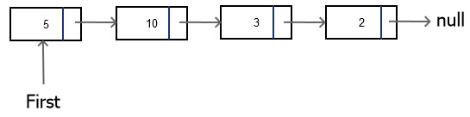
Linked Lists
A data structure that consists of nodes, where each node stores data and contains a pointer to the next node.

Slide 15
LinkedList vs. ArrayList
Both implement the interface List
You can add items, change items, remove items, and clear the list.
LinkedList and ArrayList function very similarly, but they are stored differently
ArrayList is implemented with an array and a size field
LinkedList is implemented as separate nodes with pointers to each other

Slide 16
LinkedList methods
addFirst(value) | adds value at beginning of list
addLast(value) | adds value at end of list
removeFirst() | removes first element of the list
removeLast() | removes last element of the list
getFirst() | returns first element of the list
getLast() | returns last element of the list

Slide 17

Problems

Slide 18
Question 1
Write a method that removes all numbers larger than 100 and smaller than 0 from an ArrayList of integers. That is, after your method is called all of the integers in the ArrayList should be between 0 and 100.

Slide 19
Question 2
Write a method that adds a copy of each element currently in an ArrayList of strings to the end of the ArrayList.
For example, if the ArrayList contains the words {“yeet”, “yaheet”, “spleet”, “yoink”}, the ArrayList should contain {“yeet”, “yaheet”, “spleet”, “yoink”, “yeet”, “yaheet”, “spleet”, “yoink”} after the method is called.

Slide 20
Question 3 (Challenge)
Using the LinkedListNode class we created during class, build a linked list of the integers {4, 8, 7, 2, 3, 5}, in that order.
Can you write code that allows you to insert nodes into the linked list like we talked about in class?

